Slide 1


Alpha Phi Omega
Chi Chapter at UCLA
Alpha Kappa / David A. Emery Term, Meeting 3
October 23, 2013
www.apo-x.org

Slide 2
Agenda
1. Officer Updates and Announcements
2. Chapter Business
a. Alpha Kappa Budget
3. Last Announcements

Slide 3
President
Holly Fuong
president@apo-x.org
Executive Committee
excomm@apo-x.org

Slide 4
[L] APO is for Life Webinar
No confirmation page/email.
Screenshot your registration email + send in your essay (for Actives). :)

Slide 5
Workshop Reminders
Pledges:
Do not need to submit write-ups.
Do need to submit confirmation you attended (screenshot).
Actives:
Submit write-ups + confirmation.
Due date: 1 week after the workshop to apoxpresident@gmail.com. Pledges, also send to your Pledge Parents.

Slide 6

Philanthropy Events

Slide 7
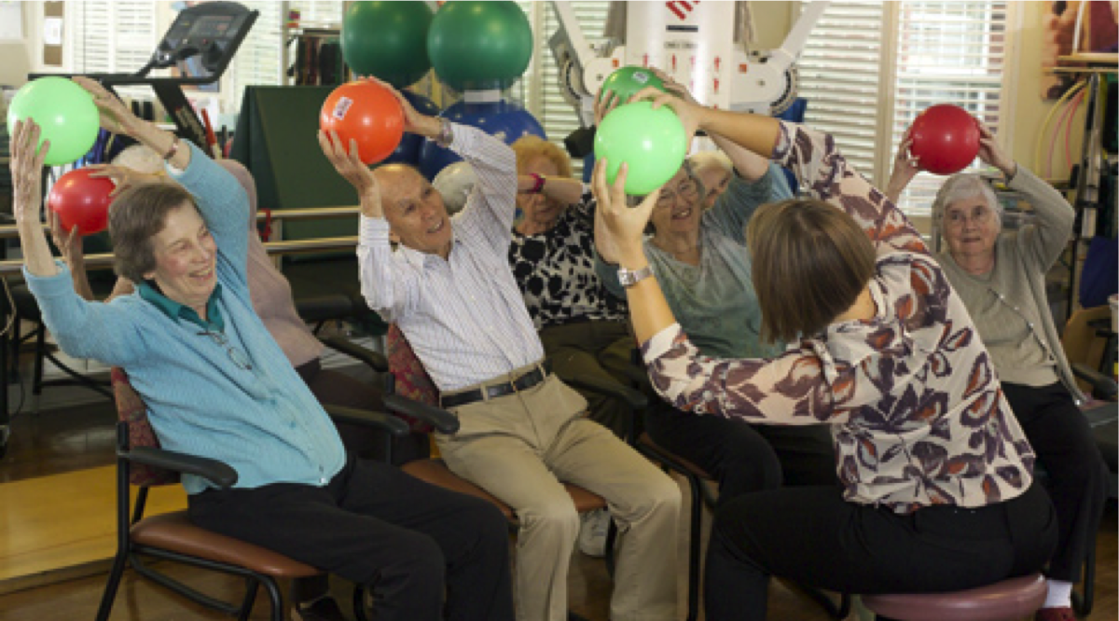
Belmont Village Senior Living

Slide 8
Belmont Village Senior Living
Located along Wilshire Boulevard (30 minutes walk from the hill)
Events:
Organizing donated books
Doing Crafts with Circle of Life residents with early stage cognitive impairment every Wednesday 3.30-4.30pm starting from 11/6
Events will be out on the calendar soon!
Brothers are highly encouraged to sign up for these events on a consistent basis

Slide 9
Administrative VPs
Jacqueline Pan & Melanie Teepronpirut
admin@apo-x.org

Slide 10

Newsletter
Hope you enjoyed our first newsletter :)))

Slide 11
Tumblr
Send pictures to:
will_nguyen2005@yahoo.com
Our tumblr is www.apochichapter.tumblr.com

Slide 12
Membership VPs
Vivian Kwan & Sean Tran
membership@apo-x.org

Slide 13

Active Contracts
ARE DUE TODAY! WHATTTTTT?!
Sign the contract
Request to be on a committee
PAY $75
BEST TERM EVA!

Slide 14
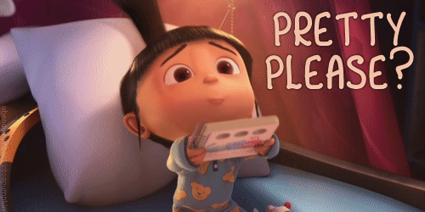
Campout
IS COMING UP! THIS COMING WEEKEND.
Need drivers please!

Slide 15

Spirit Committee
LET’S SEE THAT EDM SPIRIT

Slide 16
Next week’s theme….

Slide 17

Service VPs
Kevin Qiu & Gabrielle Taylor
service@apo-x.org
that i’m not here :/

Slide 18

Upcoming Service
STAR Education Enchanted Hallow’s Eve - if you’re not going to Campout on Sunday
EnrichLA Gardening -- November 2
Light the Night Walk - November 2
Stone Creek Restoration with CIRCLE K - November 16

Slide 19
Pledge Parents
Hamilton Luu & David Yuan
pledgeparents@apo-x.org

Slide 20
Mission 2 Toast Song
Mission 3: Music Video due at CM 5
Interviews: 20 Actives
Quiz: Chairing Guidelines, symbols, Objectives

Slide 21
Campout
Friday-Sunday
Coulter Group Campgrounds Site 001 (Los Angeles National Forest)
WE NEED DRIVERS FOR SATURDAY/SUNDAY
Saturday is a good opportunity to meet pledges and bond with your brothers
Big/Lil?
Active Activities start at 10:00 A.M. on Saturday

Slide 22
Finance VPs
Alejandra Chavez & Raymond Mai
finance@apo-x.org

Slide 23
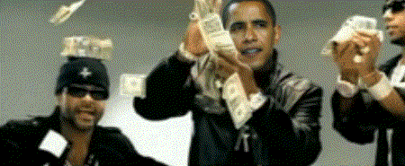
Dues
ACTIVES PAY DUES BY TODAY
PLEDGES ON PAYMENT PLAN PAY 2ND INSTALLMENT TODAY
BY CASH OR CHECK

Slide 24
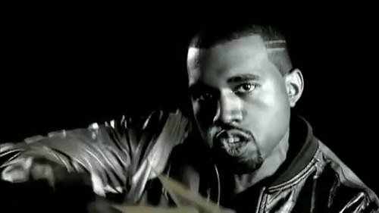
Campout Gas Reimbursements
All Alumni/Actives/Pledges will be reimbursed at a rate of $0.21
Qualification for reimbursement: Minimum of 2 alumni/good standing actives/pledges in the vehicle (Miles used to shuttle people will count)

Slide 25
Fundraisers!
Fundraisers
BJs and Veggie Grill Fundraisers
TV Taping for Tuesday, payout $25, 5 min
Contact Alejandra for questions/concerns/suggestions on fundraisers:
Text: (562)316-7908
Email: alejandrac@g.ucla.edu or ialejandrachavez@gmail.com
PLEASE! include your name

Slide 26

Have a Swag’d Up Week, Bro

Slide 27
Fellowship VPs
Jessica Cui & Kevin Quizon
fellowship@apo-x.org

Slide 28
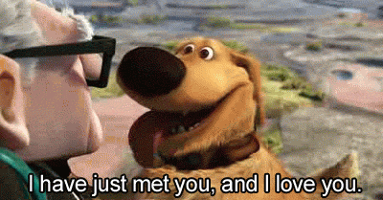
Secret Brother
Turn in your presents to us or Secret Brother Committee (Nicola & Cindy) by CM4!

Slide 29
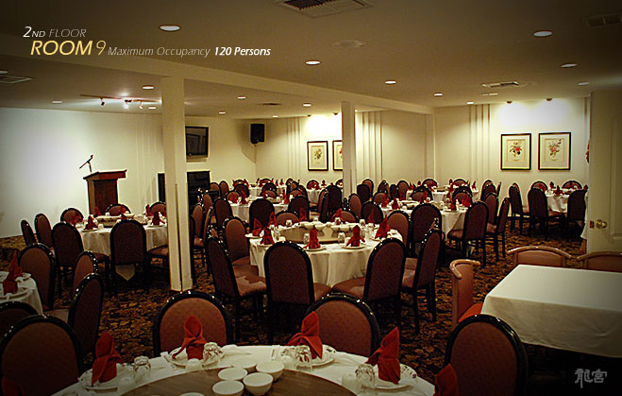
LGN
The Dragon Restaurant 10/22
$21.00 for first 100 good standing associates, alumni and pledges.
$25.00 for after 100 and bad standing actives

Slide 30


LGN Talent Show!
Showcase your talents to your brothers!
Let us know if you’re interested!

Slide 31
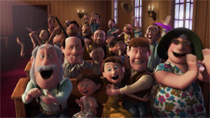
Support IM team!
Volleyball, 10/28 7:30PM SAC
Flag Football, 10/31 7:00PM IM Field

Slide 32
Historian
Selena Saenz
historian@apo-x.org

Slide 33




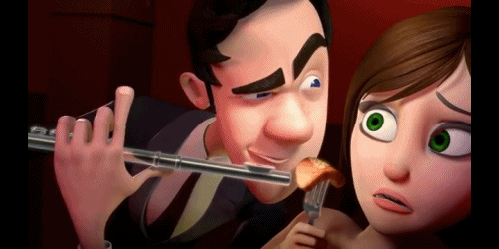
Top Hit of the Week?

Slide 34
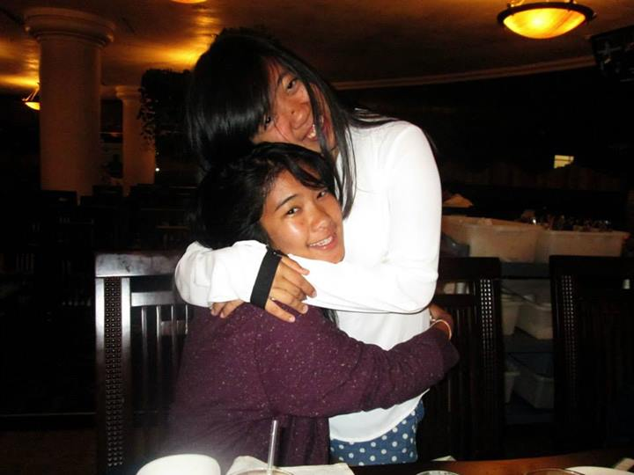
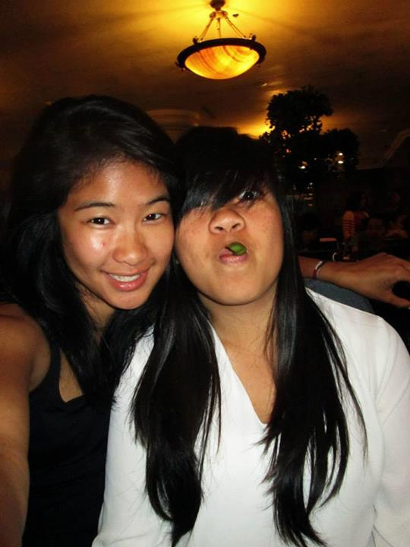
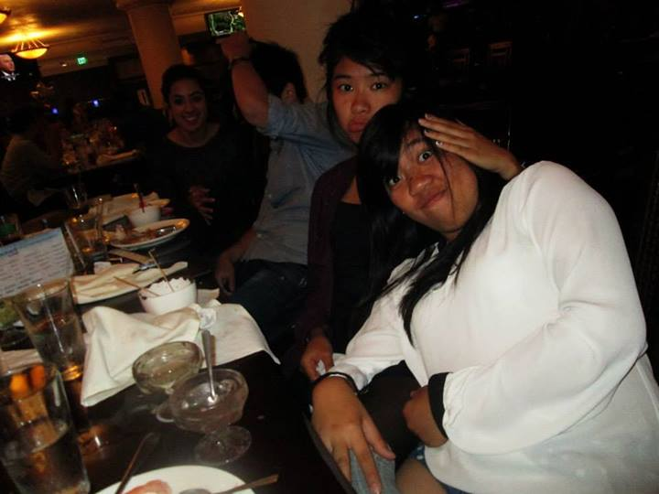
Patricia Natalie & Emily Neai-Proeung

Slide 35



CHI Trivia
CHI chapter was WUGed in November 13, 1931.
In 1978, the chapter was deactivated.
In 1997, Chi Chapter was formally rechartered.
The initiation took place at 2209A WUG Hall. WUG WUG and WUG WUG WUG were present.

Slide 36
Sergeant-at-Arms
Maria Valenzuela
saa@apo-x.org

Slide 37
Meeting etiquette
Be respectful to those speaking during meeting
When an Excomm member is explaining something, please refrain from talking over them
If you have a question/comment/concern please wait your turn.

Slide 38
A.B.E.A
Dan Tamayo
1. Flake-ins: Ivy Nguyen ( Flaked in for Bryan Park). David Yuan (Flaked in for Clare Tong) Late: None. Flakes: Bryan Park. Clare Tong.Chair: I signed up to be a chair three days before the event. 2. Pins/letters: Everyone came with pins taken off for workout but they all have pins. 3. Event description: I decided to meet all attendees in front of the Wooden Center entrance. The first person that came was Talia, then Rui, then Alex, then Ivy who was inside the gym already and then there was David holding a wetzel pretzel before workout which i found odd. As we went inside the gym, we decided that we were going to do our own separate workouts. So I let them go and told them to meet me by the gymnastics area room 5 mins before 6 so we can cool off and take picture. Once I let them go, I decided to check up on what they were doing. David and Ivy went lifting. Alex and Rui spotted each other for chest workouts like bench press. Talia and I went running on the treadmill because I found the weights room too crowded and too intimidating to lift weights. Me and Talia only did about 30 mins of running and decided to just do basic stretches on a mat. After all these tiring and sweaty workouts, we decided to take the picture, toast, and bounce. It was a tiring but fun event and I suggest having another workout event but this time drake stadium.
^ Love that line hehe

Slide 39
Policies
Name and a Check = warning
on third check = strike
A strike will result in a email from SAA explaining the reason for the strike so there are no misunderstandings.

Slide 40
Interchapter Chair
Olivia Pardo
interchapter@apo-x.org

Slide 41

THANK YOU...
for your enthusiastic and friendly attitudes during last week’s IC event with Lambda Mu!
YOU MAKE ME SO PROUD! Keep it up!

Slide 42
Events
IC Penpal
Send me your penpal names by TONIGHT!
Lots of events coming up so SIGN UP! :D

Slide 43
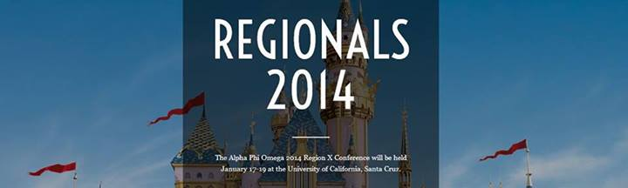
“Let the Memories Begin!”
January 18th - 19th, 2014
University of California, Santa Cruz

Slide 44
Chair of the
Advisory Committee
Tristan Darvin
cac@apo-x.org

Slide 45
Chairman Updates!
- CAC Office Hours this week
12:00PM to 2:00PM (Friday, 10/25)
Somewhere in Westwood
Please call - (760) 218-1479

Slide 46
Chairman Updates!
- Need to Discuss Matters?
Chapter Matters
Issues with Members
Questions/Concerns
Career Advice
COME TO OFFICE HOURS/CONTACT ME!
*Anonymity will be respected*

Slide 47
To: Alpha Kappa
Remember, CAC Interview does not count towards your Alumni Interview Total

Slide 48
Career/Internship Opportunities
IviGen
Looking for a per diem Laboratory Technologist
Provide Genetics Screening Analysis on Embryos
TeeWii
Looking for a Graphic Designers
Emphasis on Women’s Interest and Design
Website Presentation
Raytheon
Looking for a Environmental Health & Safety Intern
Reporting and Assisting with Compliances for an Engineering Co.

Slide 49
Chairman Updates!
Words of Wisdom
“When reviewing your notes before an exam, the most important will illegible”

Slide 50

Chairman Updates!
GOOD LUCK WITH EXAMS!!!

Slide 51
Chapter Business

Slide 52
Alpha Kappa Budget

Slide 53
Special Elections - MVP
Vivian Kwan and Jeremy Gozzip

Slide 54
Last Announcements

